Slide 1
Steelhead Annual Loss Prediction
Chase and Brian

Slide 2
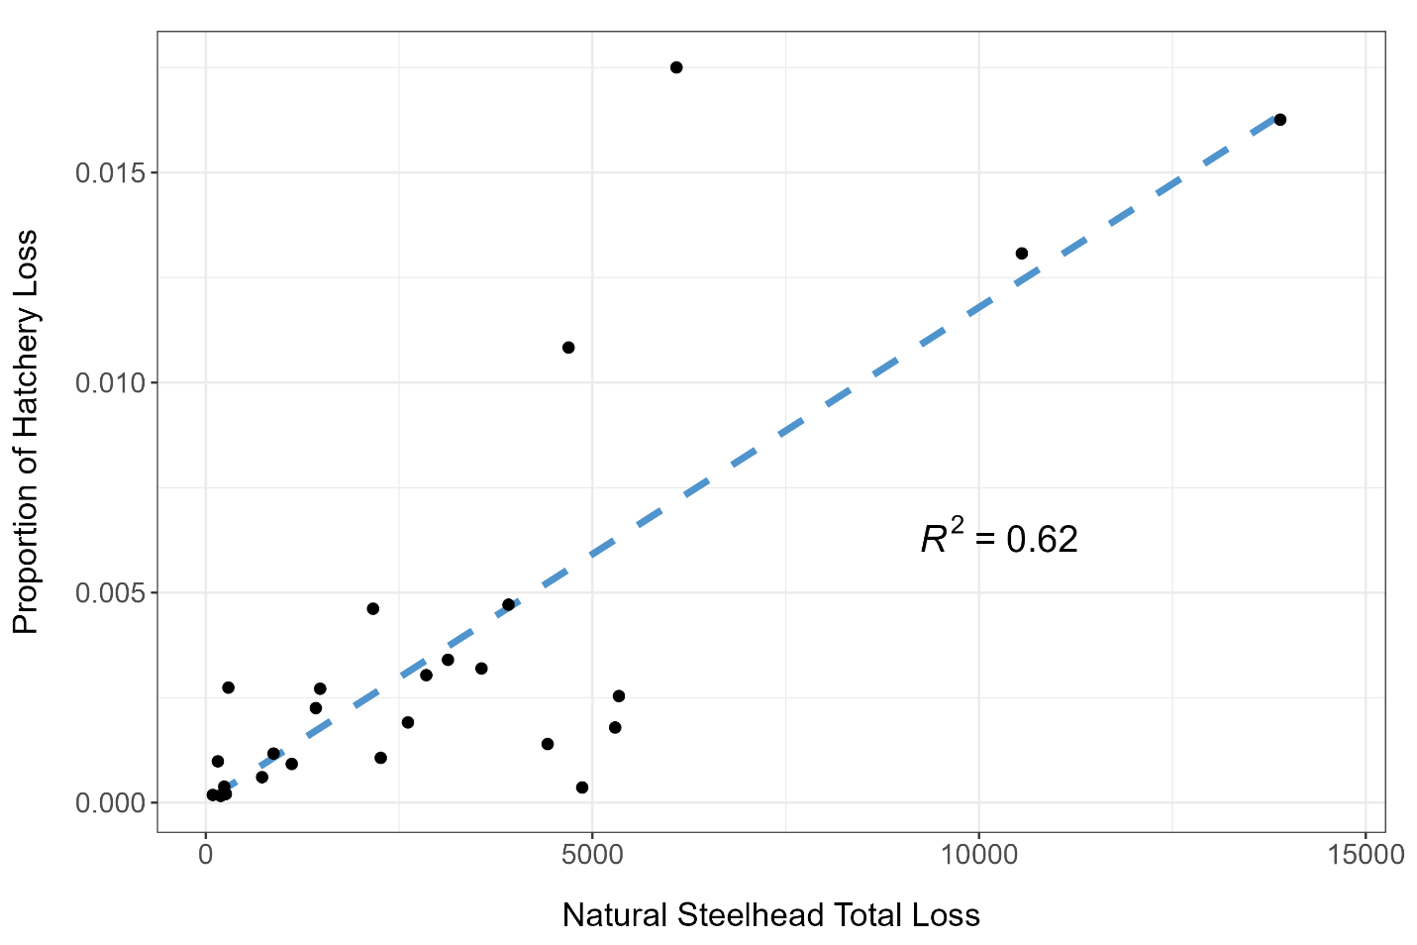
Hatchery Loss v Natural Loss

Slide 3
Predict with water year types?
Past water year types would partially determine future steelhead life history strategies
Early life history survival
Growth
Density-dependence
Etc.
Majority of outmigrants are age 2 smolts
We looked at previous 2 years water types as they relate to current year salvage
Just the San Joaquin Index for now
Salvage Year | WY type - 1 | Wytpe - 2
2024 | 2023 | 2022
2023 | 2022 | 2021
2022 | 2021 | 2020
2021 | 2020 | 2019

Slide 4
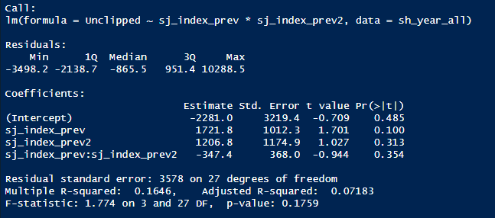
Using all years of salvage (1995-2024)
Simple linear regression to start off with.
Fit for all years of salvage was poor.
No significance in the covariates or intercept
R-squared was low

Slide 5
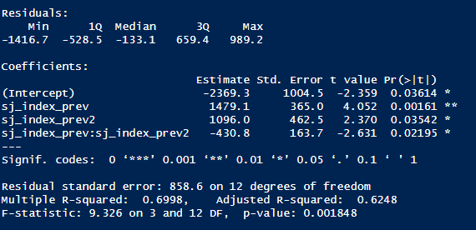
Post 2008 BiOP years (2009-2024)
Simple linear regression
Fit was much better
Significance in the intercept and covariates
Much better R squared value

Slide 6
More Robust Model
Negative Binomial Model using Loss as the response variable
Covariates
Previous water-year types
San Joaquin and Sacramento Indexs from previous water year and from 2 water years ago
Facility (SWP and CVP)
Current year real-time data
Averaged by year from Jan-June
Previous Year’s data
sj_index_prev
sj_index_prev2
sac_index_prev
sac_index_prev2
Categorical
Facility (SWP or CVP)
Current year real-time data
Freeport Flows
Vernalis Flows
OMRI
Exports

Slide 7
Model Selection
Removed Collinear Variables
Vernalis, sac_index_prev2
Ran full model with all remaining variables
Facility, OMRI, exports, freeport, sac_index_rev, sj_index_prev, & sj_index_prev2
Ran multiple models with combinations of all variables
Top model included facility, and sj_index_prev with an AICc of 449

Slide 8
Model Selection pt. 2
We hypothesized that an interaction between the two previous San Joaquin Water Years was an important predictor of loss
Reran the full model including this interaction
All covariates + sj_index_prev*sj_index_prev2
Ran multiple models with combinations of all covariates and interactions
Top 5 models included this interaction
Top model included several ‘real-time’ covariates
exports, facility, OMRI, freeport
Performed k-fold cross-validation on top-5 models
Top model remained the same
Top model AICc = 445.6

Slide 9
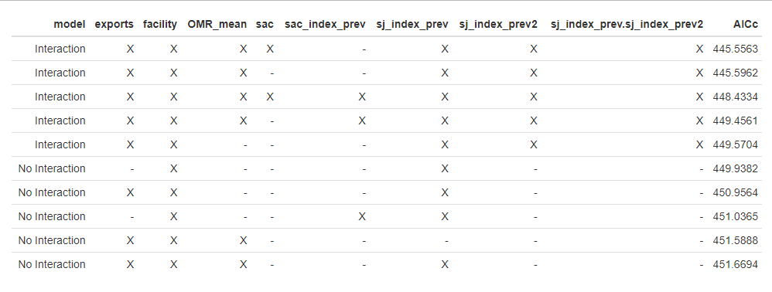
Model Selection pt. 2b

Slide 10
What explains the most variation?
Term | Δ Deviance
facility | 91.2
sj_index_prev:sj_index_prev2 | 55.8
exports | 52.2
OMR_mean | 44.0
sac | 38.6

Slide 11
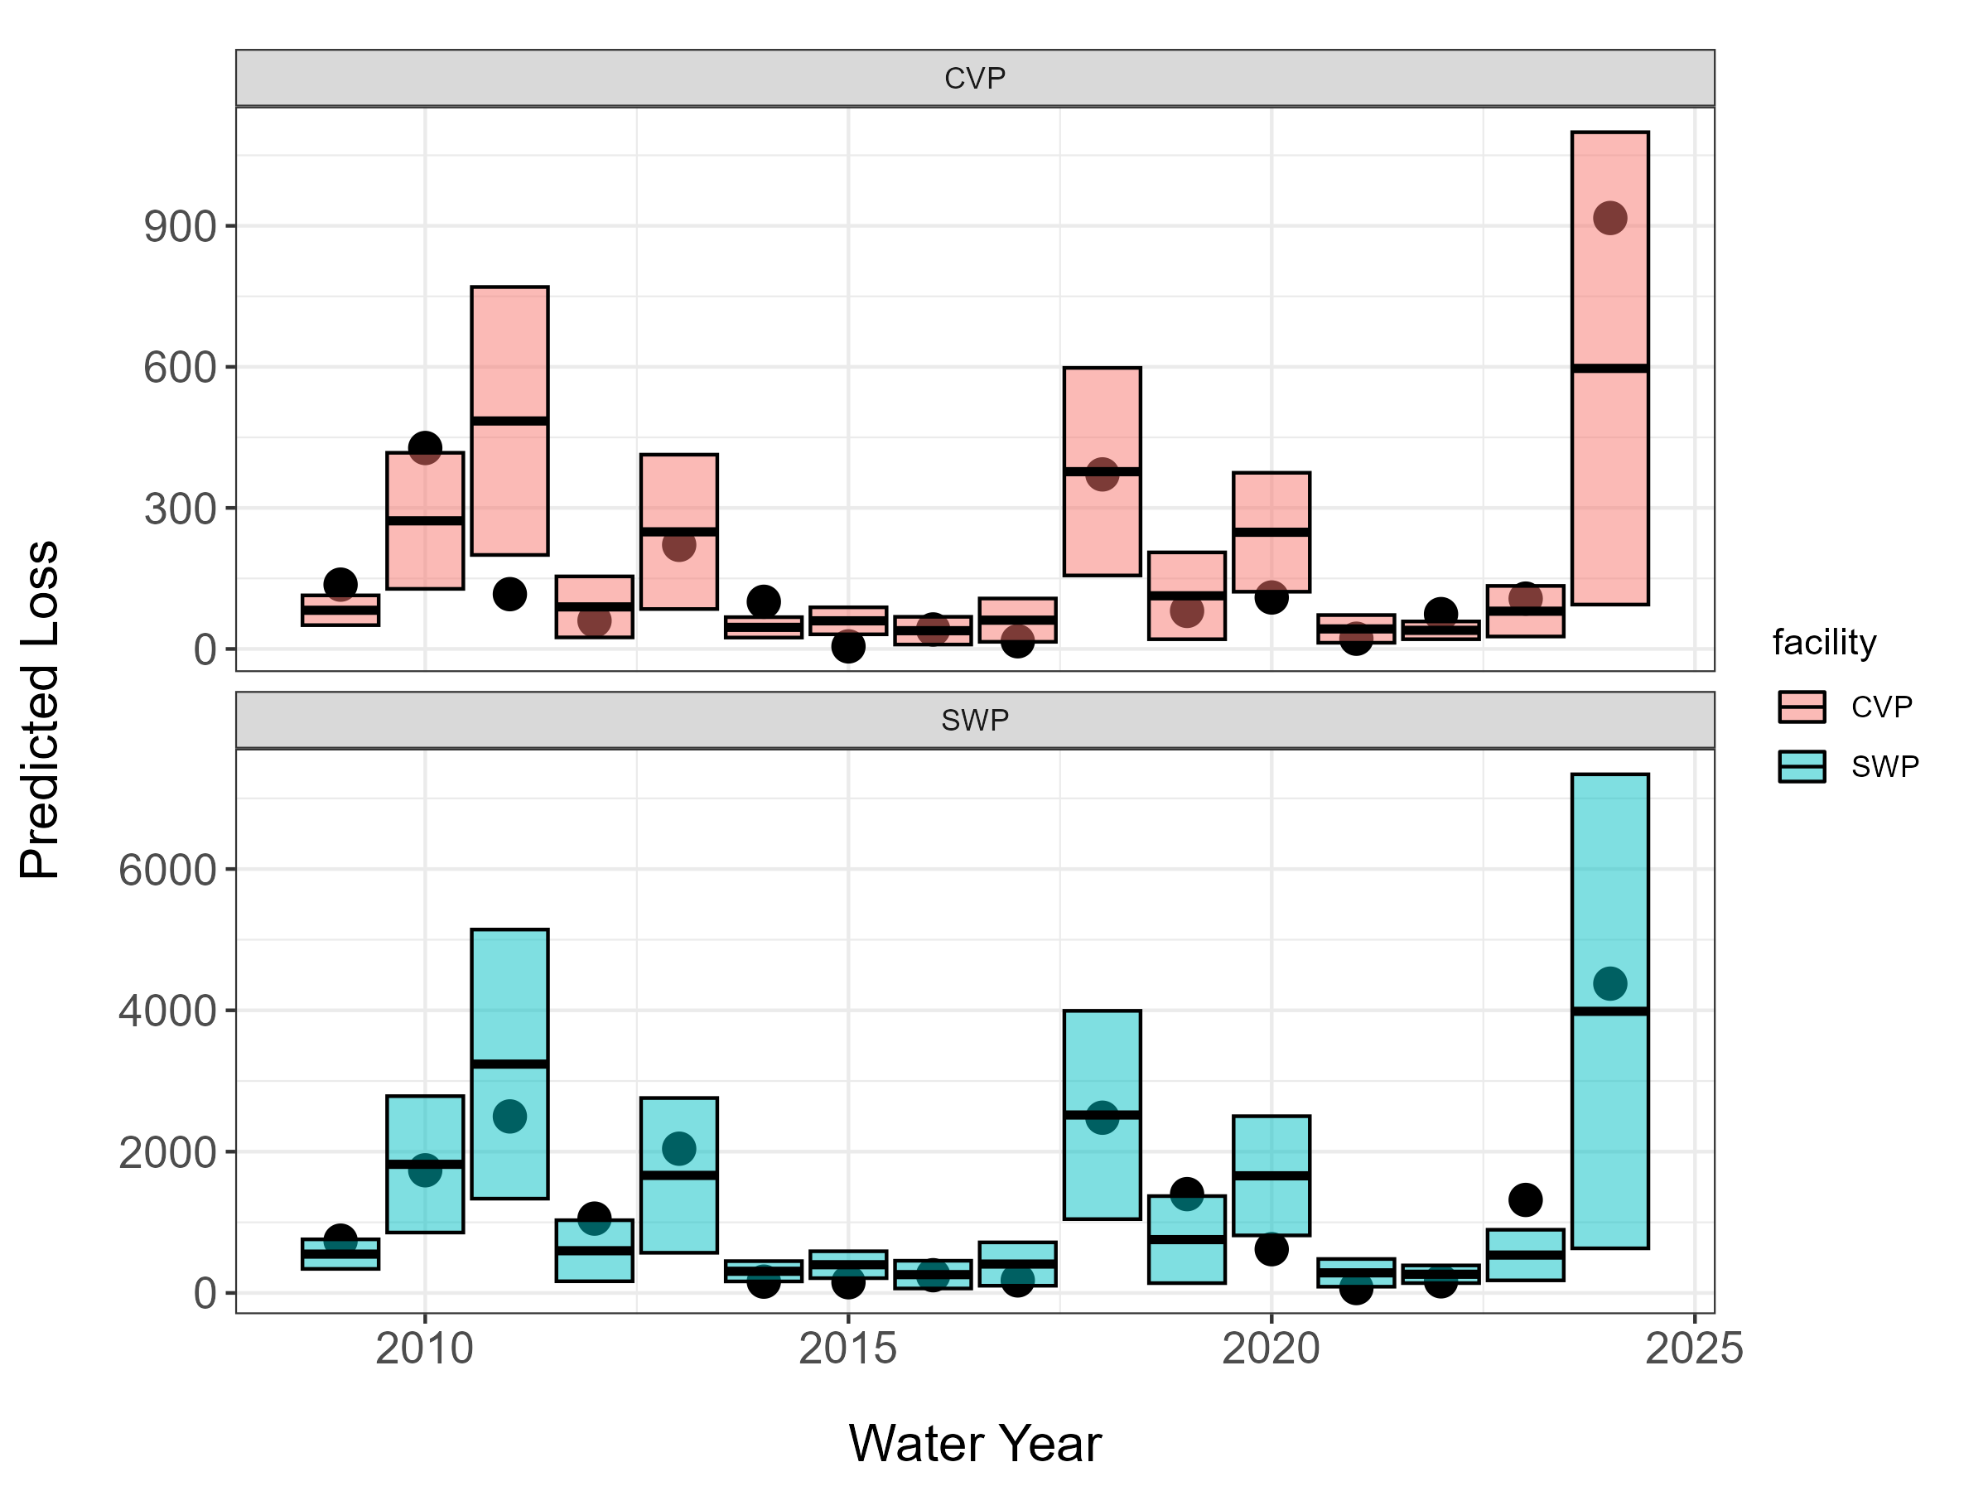
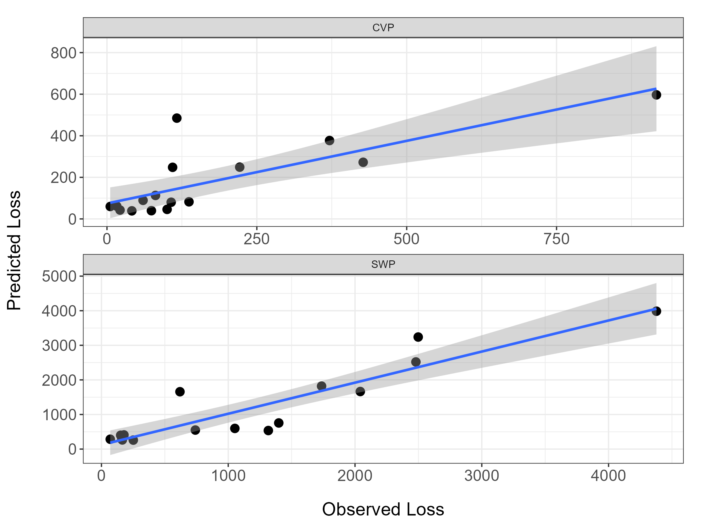
How well does it predict?

Slide 12
Next steps and discussion
Can it forecast loss?
May have to average real-time covariates or remove them all together
AICc increases by approximately 5 if real-time covariates are removed.
Write into a note
Integrate into JPE development
Start presenting at conferences?

